Slide 1
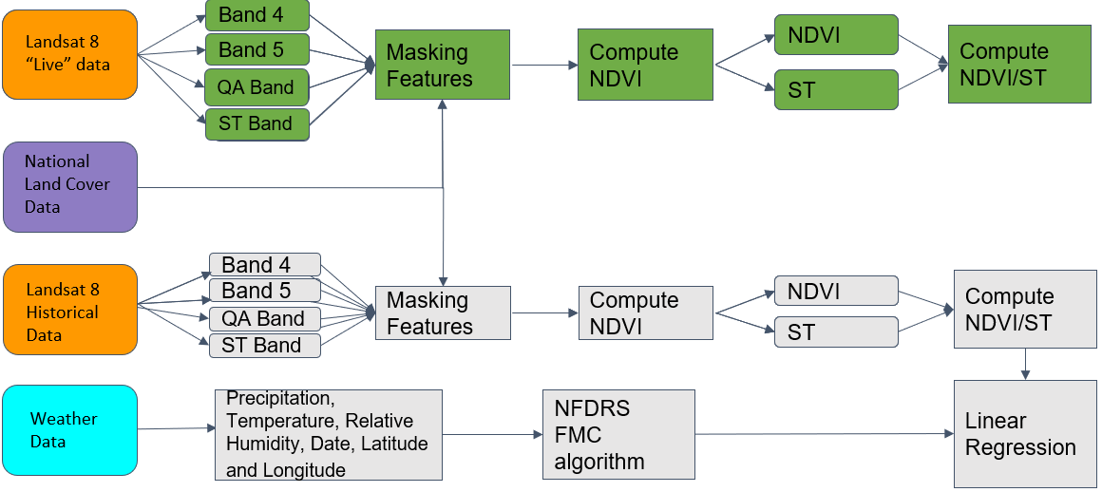
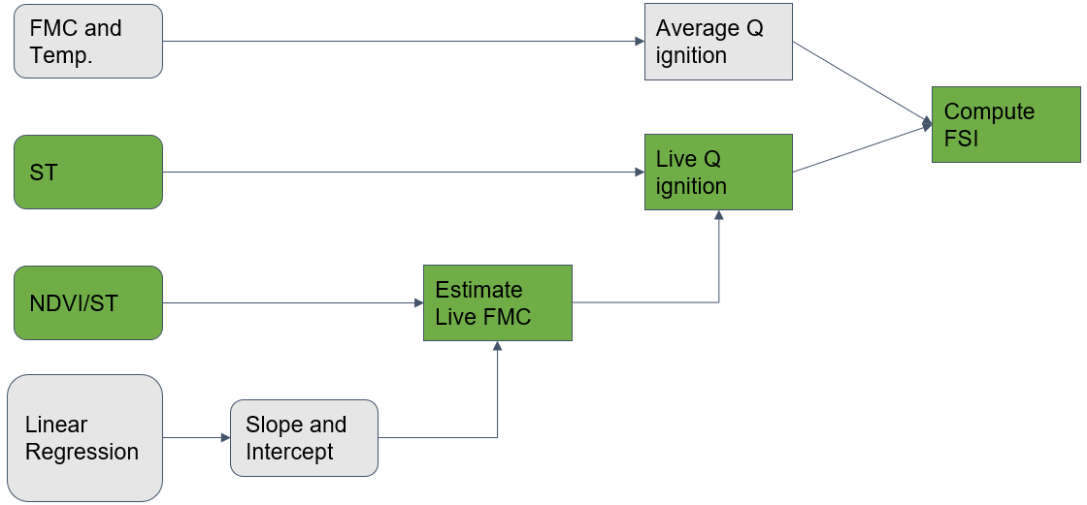
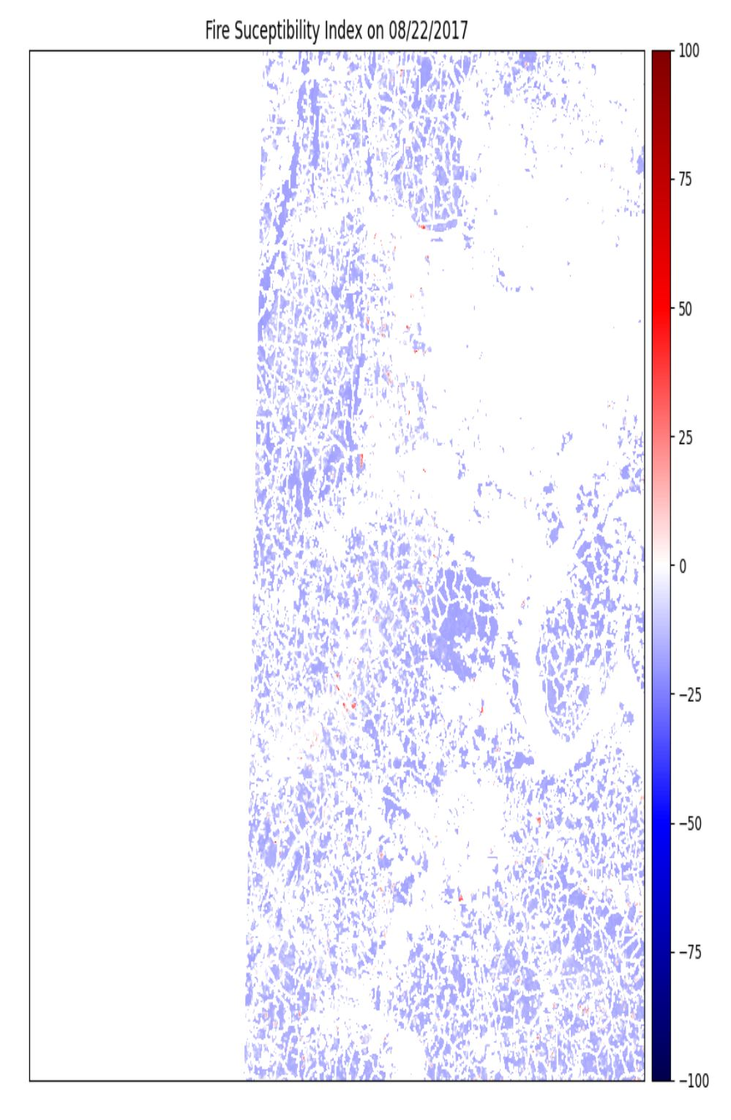
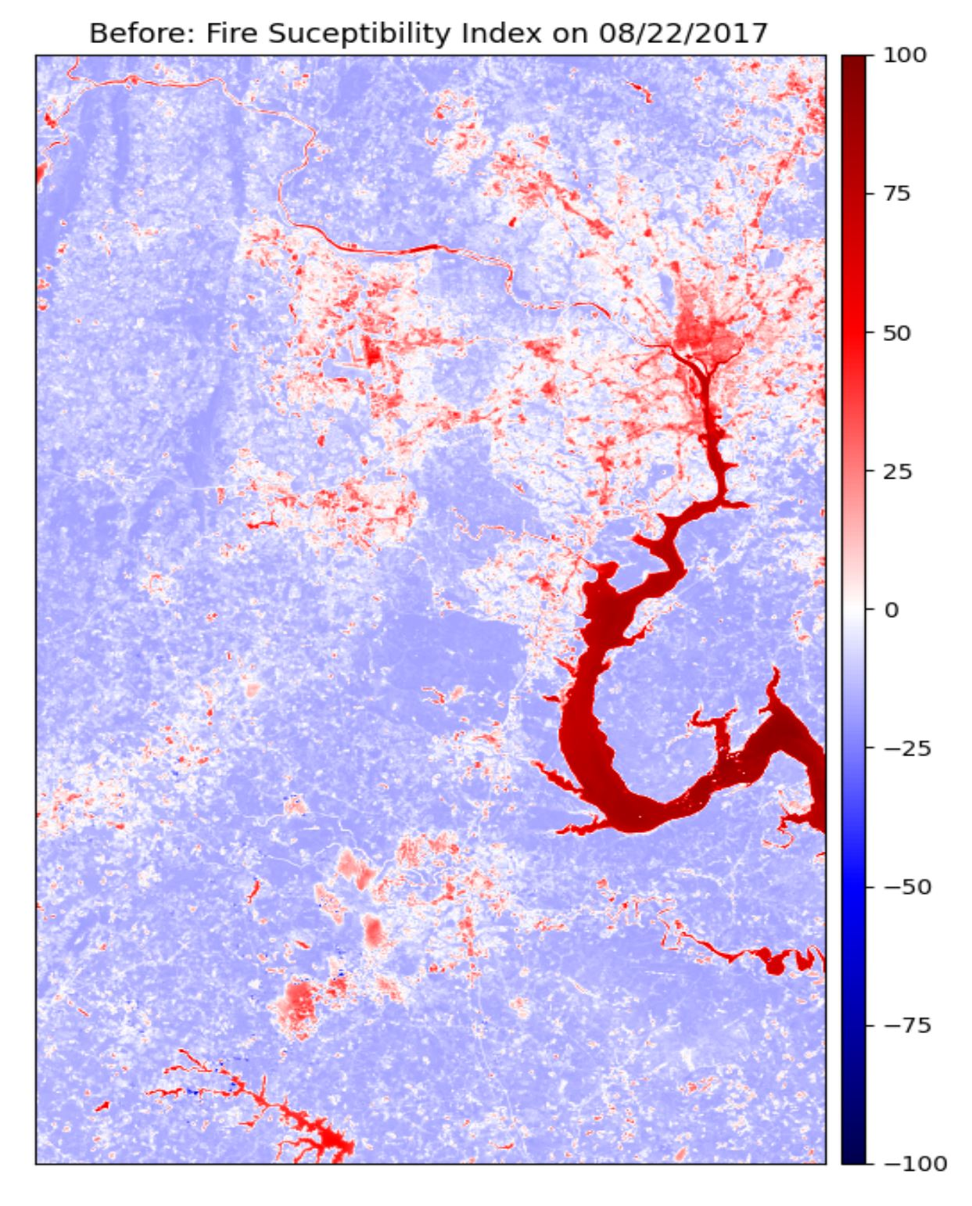
Wildfire risk, assessment and prediction
The power of MASKING:
Images below show error caused by cloud, water and urban areas. This is resolved by masking via NLCD
Fire Susceptibility Index (FSI): geospatial data that models wildfire risk
Hindered by 2 factors: broad scale, data intensive
Biggest challenge: Wildland urban interface (WUI) – 2020 saw 295 fires in VA, 4200 acres burned, 23 structures damaged
FSI uniquely positioned to help solve these problems:
VT used Landsat data for remote sensing, as well as the NFMD* database to collect FMC, and correlated the two
Determined NDVI** using linear regression with correlated FMC
Used NLCD*** data to mask urban and water areas for FSI application
*National Fuel Moisture Database
**Normalized Difference Vegetation Index
***National Land Cover Database

